Slide 1
Project- Controlling traffic light
The Arduino traffic light controller is a simple project. A traffic light controller assists in traffic management and traffic control. These devices are installed at road crossroads or crossings to prevent traffic congestion and accidents. The systems alert the motorist by employing various colors of light. As a result, avoiding congestion at junctions is straightforward.
In this project, we are going to make a traffic light control for a four-way intersection. We will learn about traffic lights and how they work through an electronic project.
Components Required
Arduino
12 pieces of 220-ohm resistors
4 pieces of breadboard
Connecting wires
Red, yellow, and green LEDs

Slide 2
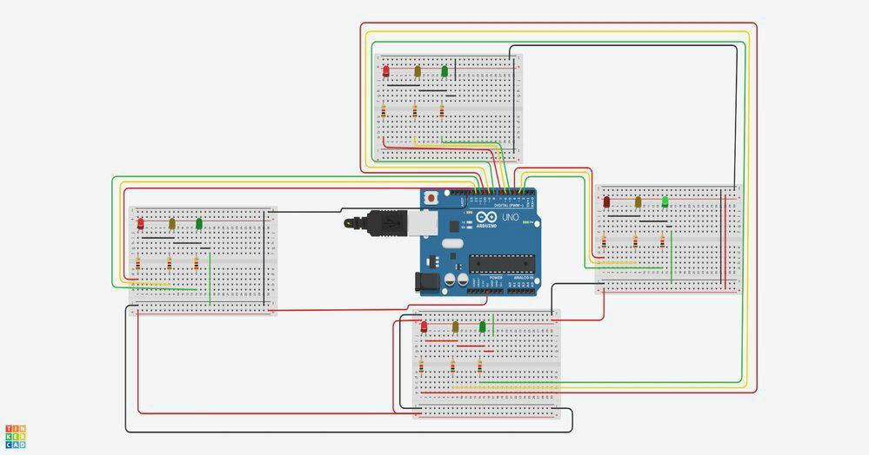
Circuit Diagram
Connect the components as mentioned in the circuit diagram

Slide 3
Arduino Code for the Traffic Light
Assign the traffic lights pins to variables int d_red =10;
int d_yellow =9;
int d_green =8;
int r_red =4;
int r_yellow =3;
int r_green =2;
int l_red =13;
int l_yellow =12;
int l_green =11;
int u_red =7;
int u_yellow =6;
int u_green =5;

Slide 4
Configure the traffic lights as outputs
void setup() {
pinMode(d_red, OUTPUT); pinMode(d_yellow, OUTPUT); pinMode(d_green, OUTPUT); pinMode(r_red, OUTPUT); pinMode(r_yellow, OUTPUT); pinMode(r_green, OUTPUT); pinMode(l_red, OUTPUT); pinMode(l_yellow, OUTPUT); pinMode(l_green, OUTPUT); pinMode(u_red, OUTPUT); pinMode(u_yellow, OUTPUT); pinMode(u_green, OUTPUT);
}

Slide 5
3. Use loop function to keep the lights in a loop and use changeLights() function to carry out the logic.
void loop()
{
changeLights();
}
void changeLights()
{
//Start (all yellow) digitalWrite(u_red,LOW); digitalWrite(d_red,LOW); digitalWrite(r_red,LOW); digitalWrite(l_green,LOW); digitalWrite(u_yellow,HIGH); digitalWrite(d_yellow,HIGH); digitalWrite(r_yellow,HIGH);

Slide 6
digitalWrite(l_yellow,HIGH);
delay(5000);
//UPPER LANE GO
digitalWrite(u_yellow,LOW);
digitalWrite(d_yellow,LOW);
digitalWrite(r_yellow,LOW);
digitalWrite(l_yellow,LOW);
digitalWrite(u_green,HIGH);
digitalWrite(r_red,HIGH);
digitalWrite(l_red,HIGH);
digitalWrite(d_red,HIGH);
delay(10000);

Slide 7
//ALL YELLOW
digitalWrite(u_yellow,HIGH);
digitalWrite(d_yellow,HIGH);
digitalWrite(r_yellow,HIGH);
digitalWrite(l_yellow,HIGH);
digitalWrite(u_green,LOW);
digitalWrite(r_red,LOW);
digitalWrite(l_red,LOW);
digitalWrite(d_red,LOW);
delay(5000);
//RIGHT LANE GO
digitalWrite(u_yellow,LOW);
digitalWrite(d_yellow,LOW);
digitalWrite(r_yellow,LOW);

Slide 8
digitalWrite(l_yellow,LOW);
digitalWrite(u_red,HIGH);
digitalWrite(l_red,HIGH);
digitalWrite(d_red,HIGH);
digitalWrite(r_green,HIGH);
delay(10000);
//ALL YELLOW ON
digitalWrite(u_yellow,HIGH);
digitalWrite(d_yellow,HIGH);
digitalWrite(r_yellow,HIGH);
digitalWrite(l_yellow,HIGH);
digitalWrite(u_red,LOW);
digitalWrite(l_red,LOW);

Slide 9
digitalWrite(d_red,LOW);
digitalWrite(r_green,LOW); delay(5000);
//DOWN LANE GO
digitalWrite(u_yellow,LOW); digitalWrite(d_yellow,LOW); digitalWrite(r_yellow,LOW); digitalWrite(l_yellow,LOW); digitalWrite(u_red,HIGH); digitalWrite(l_red,HIGH); digitalWrite(r_red,HIGH); digitalWrite(d_green,HIGH); delay(10000);

Slide 10
//ALL YELLOW
digitalWrite(u_yellow,HIGH);
digitalWrite(d_yellow,HIGH); digitalWrite(r_yellow,HIGH);
digitalWrite(l_yellow,HIGH);
digitalWrite(u_red,LOW); digitalWrite(l_red,LOW); digitalWrite(r_red,LOW); digitalWrite(d_green,LOW); delay(5000);

Slide 11
//LEFT LANE GO
digitalWrite(u_yellow,LOW);
digitalWrite(d_yellow,LOW); digitalWrite(r_yellow,LOW); digitalWrite(l_yellow,LOW); digitalWrite(u_red,HIGH); digitalWrite(d_red,HIGH); digitalWrite(r_red,HIGH); digitalWrite(l_green,HIGH); delay(10000);
}
Code Explanation
Here the loop start with all the yellow light turned on and the green light moving in a clockwise
direction when one of the green light is on the rest of the direction will be red and it all will do a transition with the yellow light turned on in every direction.

Slide 12
4. Compile the code and upload it to the Arduino int d_red =10;
int d_yellow =9;
int d_green =8;
int r_red =4;
int r_yellow =3;
int r_green =2;
int l_red =13;
int l_yellow =12;
int l_green =11;
int u_red =7;
int u_yellow =6;
int u_green =5;

Slide 13
void setup()
{
pinMode(d_red, OUTPUT);
pinMode(d_yellow, OUTPUT); pinMode(d_green, OUTPUT); pinMode(r_red, OUTPUT); pinMode(r_yellow, OUTPUT); pinMode(r_green, OUTPUT); pinMode(l_red, OUTPUT); pinMode(l_yellow, OUTPUT); pinMode(l_green, OUTPUT); pinMode(u_red, OUTPUT); pinMode(u_yellow, OUTPUT); pinMode(u_green, OUTPUT);
}

Slide 14
void loop()
{
changeLights();
}
void changeLights()
{
//Start (all yellow)
digitalWrite(u_red,LOW);
digitalWrite(d_red,LOW);
digitalWrite(r_red,LOW);
digitalWrite(l_green,LOW);
digitalWrite(u_yellow,HIGH);
digitalWrite(d_yellow,HIGH);
digitalWrite(r_yellow,HIGH);
digitalWrite(l_yellow,HIGH);
delay(5000);

Slide 15
//upper lane go digitalWrite(u_yellow,LOW); digitalWrite(d_yellow,LOW); digitalWrite(r_yellow,LOW); digitalWrite(l_yellow,LOW); digitalWrite(u_green,HIGH); digitalWrite(r_red,HIGH); digitalWrite(l_red,HIGH); digitalWrite(d_red,HIGH); delay(10000);
//ALL YELLOW
digitalWrite(u_yellow,HIGH); digitalWrite(d_yellow,HIGH); digitalWrite(r_yellow,HIGH); digitalWrite(l_yellow,HIGH); digitalWrite(u_green,LOW); digitalWrite(r_red,LOW); digitalWrite(l_red,LOW); digitalWrite(d_red,LOW); delay(5000);
digitalWrite(d_yellow,LOW);

Slide 16
//RIGHT LANE GO
digitalWrite(u_yellow,LOW);
digitalWrite(r_yellow,LOW); digitalWrite(l_yellow,LOW); digitalWrite(u_red,HIGH); digitalWrite(l_red,HIGH); digitalWrite(d_red,HIGH); digitalWrite(r_green,HIGH); delay(10000);
//ALL YELLOW ON
digitalWrite(u_yellow,HIGH);
digitalWrite(d_yellow,HIGH); digitalWrite(r_yellow,HIGH); digitalWrite(l_yellow,HIGH);

Slide 17
digitalWrite(u_red,LOW); digitalWrite(l_red,LOW); digitalWrite(d_red,LOW); digitalWrite(r_green,LOW); delay(5000);
//DOWN LANE GO
digitalWrite(u_yellow,LOW); digitalWrite(d_yellow,LOW); digitalWrite(r_yellow,LOW); digitalWrite(l_yellow,LOW); digitalWrite(u_red,HIGH); digitalWrite(l_red,HIGH); digitalWrite(r_red,HIGH); digitalWrite(d_green,HIGH); delay(10000);

Slide 18
//ALL YELLOW
digitalWrite(u_yellow,HIGH); digitalWrite(d_yellow,HIGH); digitalWrite(r_yellow,HIGH); digitalWrite(l_yellow,HIGH); digitalWrite(u_red,LOW); digitalWrite(l_red,LOW); digitalWrite(r_red,LOW); digitalWrite(d_green,LOW); delay(5000);

Slide 19
//LEFT LANE GO
digitalWrite(u_yellow,LOW);
digitalWrite(d_yellow,LOW); digitalWrite(r_yellow,LOW); digitalWrite(l_yellow,LOW); digitalWrite(u_red,HIGH); digitalWrite(d_red,HIGH); digitalWrite(r_red,HIGH); digitalWrite(l_green,HIGH); delay(10000);
}

Slide 20
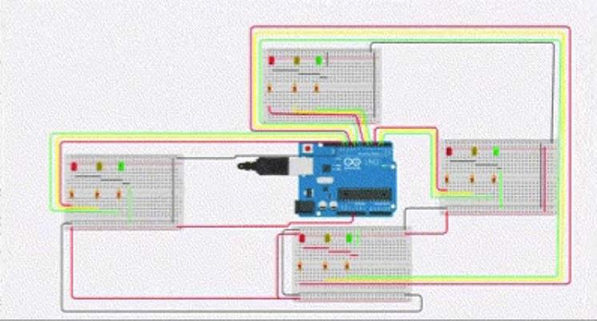
Output:

